Slide 1
JOINT & MUSCLE BLEEDS

Slide 2
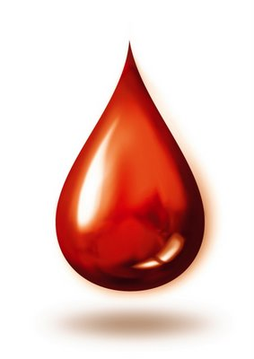
TYPES OF BLEEDS
EXTERNAL
INTERNAL
Mucosal
Nose, mouth
Menses
Skin
Abrasions
Cuts, lacerations
Incisions
Musculoskeletal
Joints
Muscles
Life threatening
Head, throat, abdomen
Severe mucosal, skin, musculoskeletal

Slide 3
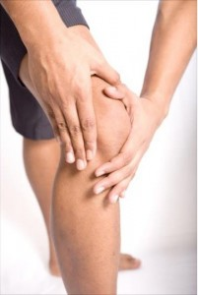
JOINT & MUSCLE BLEEDS
Anybody can have a joint or muscle bleed with enough trauma
People with bleeding disorders are more likely to:
Have joint & muscle bleeds
Bleed longer
Have a greater accumulation of blood in the joint, muscle
Have greater inflammation, swelling, pain
Take longer to heal
Have another bleed in the same location
Have permanent damage to the joint or muscle
https://www.hemophiliafed.org/home/understanding-bleeding-disorders/complications/joint-damage/

Slide 4
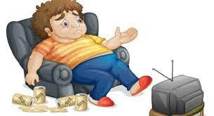
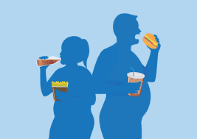
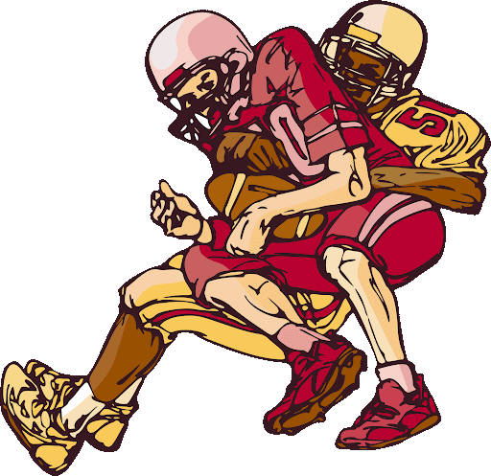
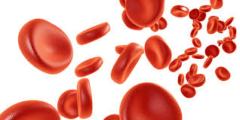
RISK FACTORS – ALL can be modified!
https://www.thehealthsite.com/diseases-conditions
Moderate or severe bleeding disorder
Overweight
Inactive
Physical activities with high contact/collision
https://www.genengnews.com/news/obesity-takes-the-brakes-off-neurological-mechanism-that-stops-oveating/
https://www.cdc.gov/ncbddd/blooddisorders/women/symptoms.html
http://www.clipartpanda.com/clipart_images/football-player-clipart-49847259

Slide 5
JOINT BLEEDS
HEMARTHROSIS

Slide 6
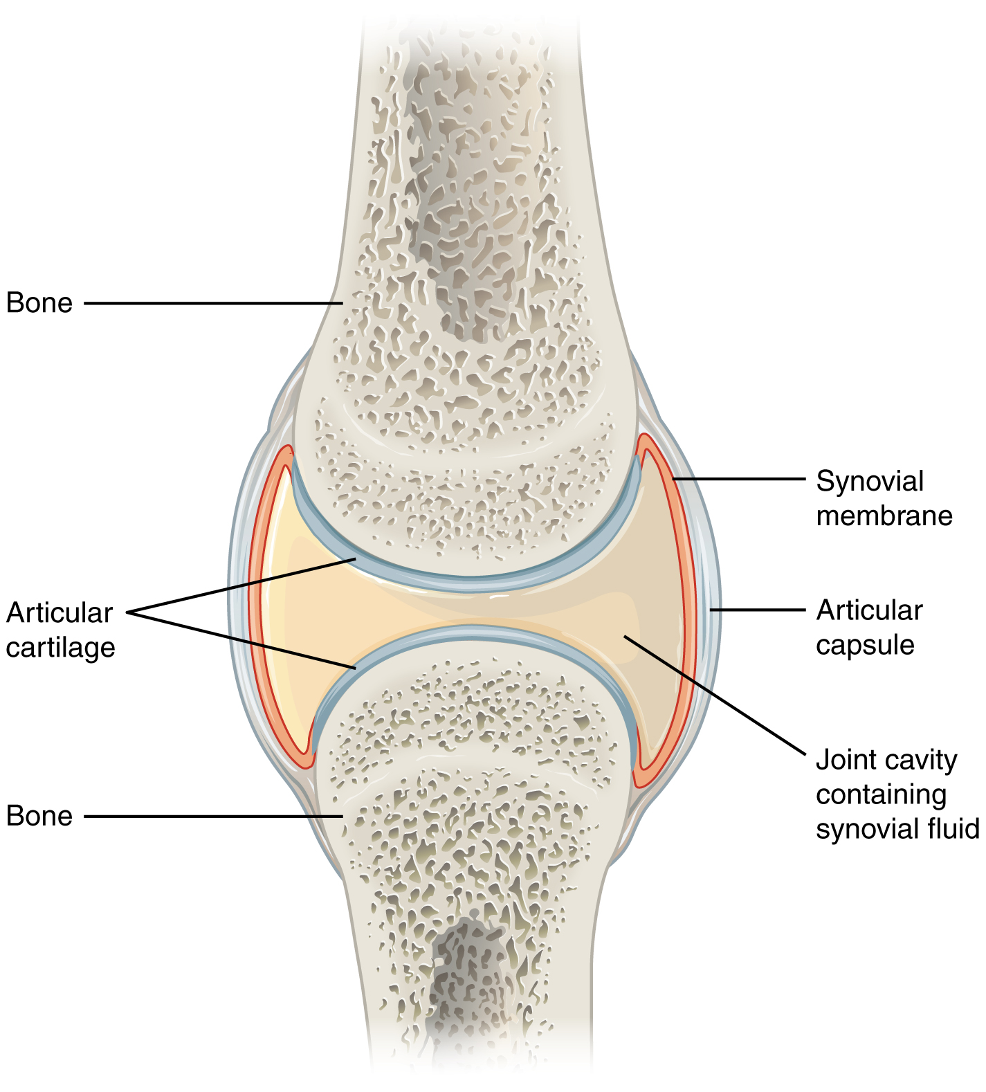
JOINT ANATOMY
Point where 2 bones meet & movement occurs
Bone ends covered in cartilage
Allows gliding
Absorbs shock
Aids in bone nutrition
Ligaments and a capsule surround joint
Help to hold joint together
Capsule is lined with synovium
Synovium
Rich in blood vessels
Makes fluid that lubricates joint
https://en.wikipedia.org/wiki/Synovial_joint

Slide 7
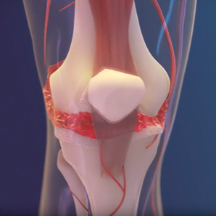
JOINT BLEEDS
Trauma to joint → injures blood vessels
Blood leaks into joint space
Blood is toxic to joint
Within minutes:
Inflammation of synovium
Pain, swelling, loss of motion in joint
Within hours:
Cracks in cartilage, collapse of cartilage matrix
Breakdown of bony surface
https://hemophilianewstoday.com/2019/09/01/your-joint-health-is-important/

Slide 8
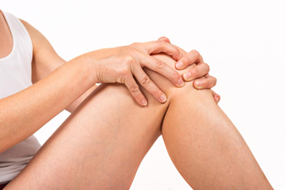
JOINT BLEED SIGNS & SYMPTOMS
May feel tingling, bubbling at start of bleed
Increasing joint pain
Increasing joint stiffness, swelling
Decreasing range of motion
Redness, warmth over joint
Will not see bruising unless other soft tissue is also bleeding
Pain increases with activity

Slide 9
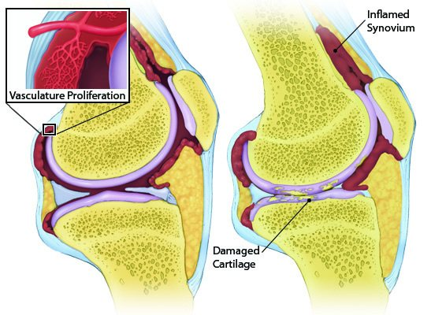
COMPLICATIONS: Re-bleed, Synovitis
New blood vessels form to aid healing
Grow in between bones
Fragile, at risk to break with minor trauma
High risk for re-bleeding
Enzymes break down blood to remove from joint
Hemosiderin too large to remove
Lays on synovium
Chronic inflammation → Synovitis
Synovium scars, thickens, stiffens
https://www.cdc.gov/ncbddd/hemophilia/course/complications/joint-disease.html

Slide 10
COMPLICATIONS: Hemarthropathy
Cartilage
Unable to heal due to poor blood supply
↓ ability to glide smoothly, absorb shock, nourish bone
New bone growth to repair damage
Misshapen – changes ‘fit’ of joint
Leads to grinding, popping, clicking, pain, instability
Hemarthropathy
Joint damage due to blood

Slide 11
MUSCLE BLEEDS

Slide 12
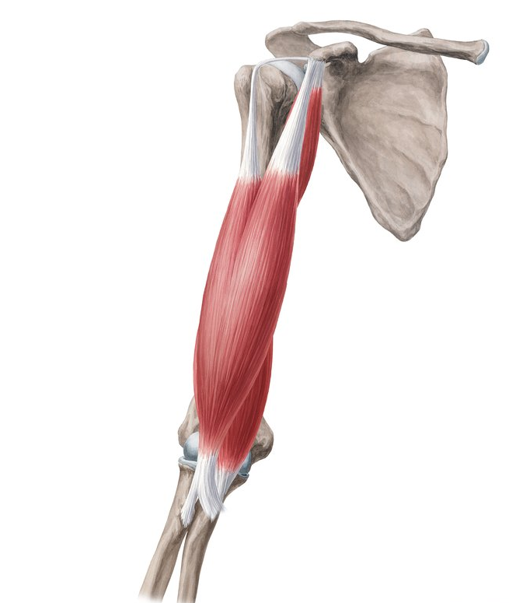
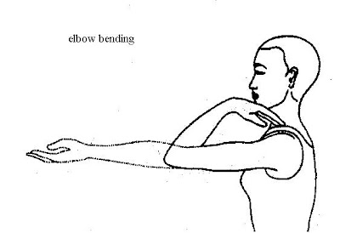
MUSCLE ANATOMY
Living muscle fibers are bundled together to form the muscle belly
Muscle belly attaches to 2 different bones by tendons
When the muscle contracts, the bones are pulled together
When the muscle relaxes, it allows the bones to move apart
https://www.kenhub.com/en/library/anatomy/arm-muscles
http://selfhealingonline.com/offer-item/elbow-bending-kehuni-naman-15/

Slide 13
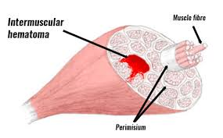
MUSCLE BLEEDS
Muscle trauma caused by:
Direct blow or injury to the muscle
Overstretching the muscle too quickly (‘pulled’ muscle)
Overworking the muscle (muscle strain) - too much force or too many repetitions
Trauma to muscle fiber → injures blood vessel(s)
Blood vessels bleed into or between the muscles
Blood causes:
Inflammation, swelling, pain in the muscles
Decreased ability to contract and relax the muscle
https://www.sportsinjuryclinic.net/sport-injuries/thigh-pain/front-thigh/dead-leg

Slide 14
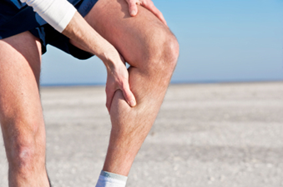
MUSCLE BLEED SIGNS & SYMPTOMS
Increasing muscle pain
Muscle stiffness, swelling
Muscle weakness or spasm
Difficulty using muscle
Decreasing joint range of motion
May become red, warm
May develop bruising
Pain increases with activity and/or weightbearing

Slide 15
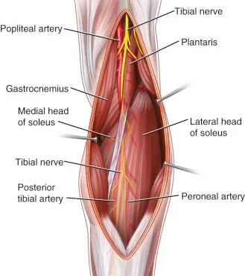
COMPLICATION: Compartment Syndrome
Large nerves, arteries and veins travel between the muscles.
Nerves carry messages from the brain to the muscles to contract and relax.e brain through nerves.
Arteries carry blood to the muscles providing them with oxygen and nutrients.
Veins carry blood away from the muscles to remove waste products.
https://plasticsurgerykey.com/soleus-flap/

Slide 16
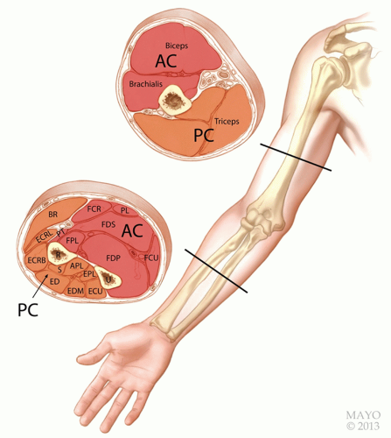
COMPLICATION: Compartment Syndrome
Muscle trauma/bleed
Large volume of blood, inflammation
Skin becomes taut
Pressure builds inside
Pressure damages nerve, artery
Nerve damage → paralysis, may be permanent
Arterial damage → gangrene, may need amputation
https://musculoskeletalkey.com/surgical-decompression-of-acute-compartment-syndrome-of-the-arm-and-forearm/

Slide 17
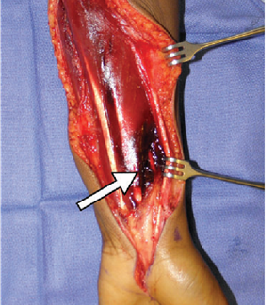
COMPLICATION: Compartment Syndrome
Signs & Symptoms:
Pain - intense
Pale
Pulseless - cool
Parasthesias - numbness/tingling
Paralysis – weakness or inability to move
Limb threatening emergency!
Go to ER
May need fasciotomy to release pressure, save limb
Lengthy recovery, may not recover fully
@article{Kim2013CASERS, title={CASE REPORT Spontaneous Forearm Compartment Syndrome in a Boy With Hemophilia A: A Therapeutic Dilemma}, author={Jennifer E. Kim and J. Zelken and J. Sacks}, journal={Eplasty}, year={2013}, volume={13} }

Slide 18
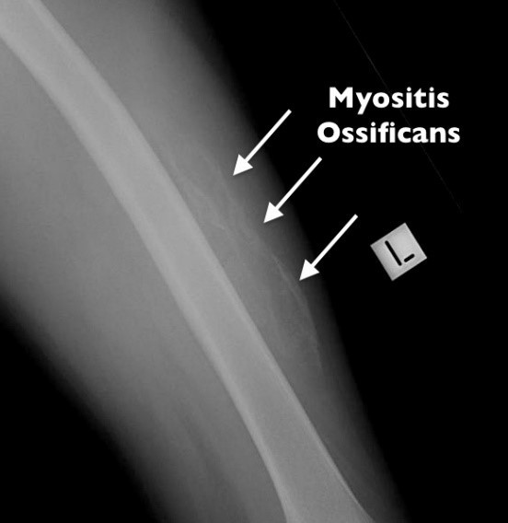
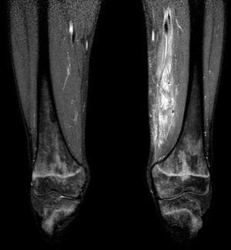
COMPLICATIONS: Other
Significant blood loss
unstable BP, iron deficiency anemia, etc.
Myositis ossificans
bone forms within the muscle
Pseudotumor
progressive cystic swelling in a muscle or bone
Abscess
collection of pus in a tissue usually due to bacterial infection
https://www.cbdwellnesscentre.com.au/post/myositis-ossificans
https://www.reumatologiaclinica.org/en-pyomyositis-inner-thigh-muscles-due-articulo-resumen-S1699258X13000466
https://europepmc.org/article/pmc/pmc7191985

Slide 19
PREVENTING JOINT & MUSCLE BLEEDS

Slide 20
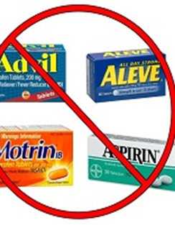
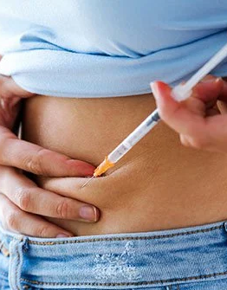
PREVENTION
If recommended by your hematologist:
Treat prophylactically (preventively)
Personalize ‘prophy’ to your physical activities
Avoid NSAIDs & Aspirin
Impairs platelets, ability to clot
Avoid or limit use of recreational substances
Impairs coordination, judgment
Increases risk of injury
Delays early recognition and treatment of bleed
https://www.youtube.com/watch?v=B_qxbb5HiuM
https://centenoschultz.com/alternative-nsaids-identify-treat-underlying-problem/
https://www.medicinenet.com/where_do_you_give_a_subcutaneous_injection/article.htm

Slide 21
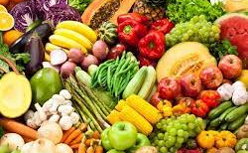
PREVENTION
Achieve and maintain a healthy weight
Eat a diet rich in fruits & vegetables, whole grains
Avoid processed foods, saturated fats, & sugar
If struggling, consult a dietitian
https://quotesgram.com/img/quotes-about-fast-food-unhealthy/4508235/
https://www.healthyfood.com/advice/how-to-be-plant-powered/
https://www.foodnetwork.com/healthy/packages/healthy-every-week/healthy-tips/things-to-know-about-seeing-a-registered-dietitian-nutritionist

Slide 22
PREVENTION
Achieve and maintain physical fitness
Start low, progress slow
Too much, too soon causes trauma to joints and muscles!
Physical activity:
Avoid activities with high contact/collision
Use appropriate protective gear
Warm up, physical activity, stretch, cool down
Listen to your body – pain is NOT gain!
NHF Playing It Safe booklet
https://www.choosept.com/resources/detail/top-10-benefits-of-physical-activity

Slide 23
Know signs/symptoms of joint bleeds
Educate key people about your bleeding disorder
Wear medical ID jewelry
Yellow Dot program
Maintain home storage of unexpired factor & infusion supplies
Have an infusion plan
Keep a Go Bag* for sports, travel and/or ER visits

Slide 24
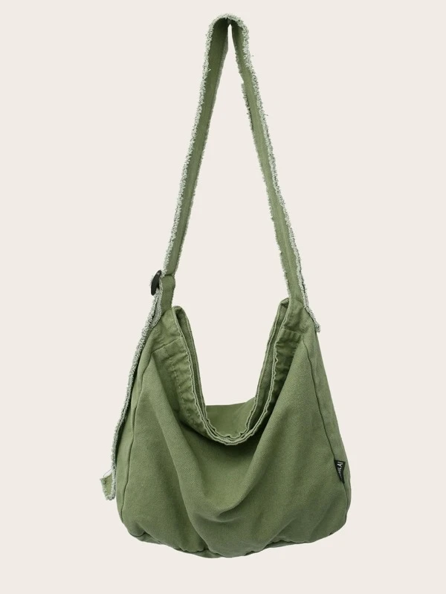
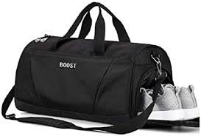
*GO BAG
Factor & infusion supplies
Phone numbers: HTC(s), PCP, other
List of medications
Instant ice packs
Elastic wraps and/or braces
Fluids & snacks
Change of clothes
Phone charger

Slide 25
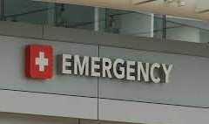
EMERGENCY ROOM TIPS
Take your Go Bag!
If no Go Bag, take factor with you
Call your HTC before you go or while you are on your way
Most ER staff unfamiliar with bleeding disorders
HTC doctor will provide guidance to ER doctor on best care
Follow up with your HTC
Additional treatment may be needed for complete recovery

Slide 26
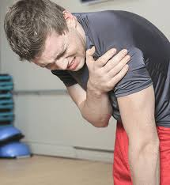
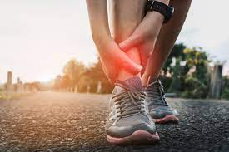
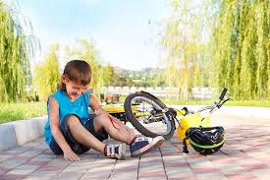
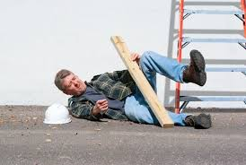
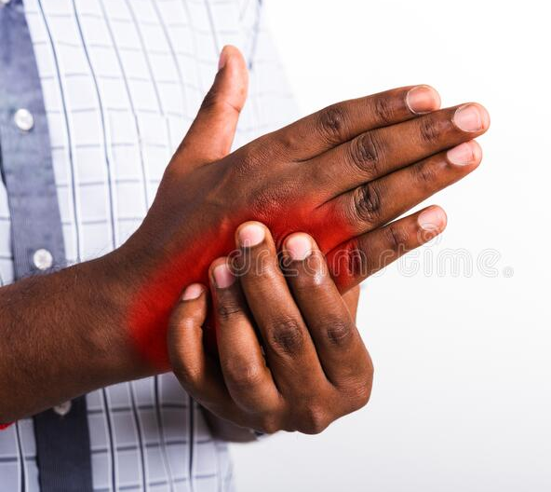
DESPITE PREVENTION…..NOW WHAT?

Slide 27
JOINT/MUSCLE BLEED TREATMENT

Slide 28
GOALS
STOP THE BLEED!
PROMOTE HEALING
REGAIN ROM & STRENGTH
RETURN TO FULL ACTIVITY

Slide 29
TISSUE HEALING
(Repair)
Than, Uyen & Guanzon, Dominic & Leavesley, David & Parker, Tony. (2017). Association of Extracellular Membrane Vesicles with Cutaneous Wound Healing. International Journal of Molecular Sciences. 18. 956. 10.3390/ijms18050956.

Slide 30
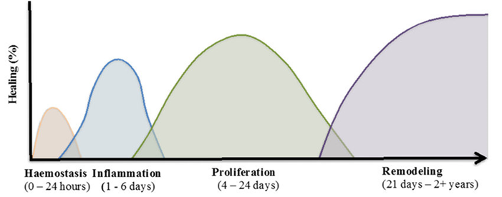
JOINT/MUSCLE BLEED TREATMENT

Slide 31
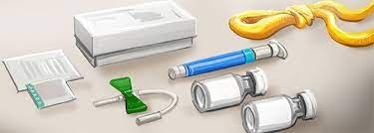
STOP THE BLEED!
PROMPT INFUSION VS.
DELAYED INFUSION
< 2 hrs from start of bleed
Strong clot forms → bleeding stops
Inflammation, pain, swelling start to subside
Healing begins
↓ # infusions, ↓ time to recover
↓ risk for permanent damage and life-long limitations
> 2hrs from start of bleed
Unable to clot → bleeding continues, blood accumulates
Inflammation, pain, swelling worsen
Healing delayed
↑ # infusions, ↑ time to recover
↑ risk for permanent damage and life-long limitations

Slide 32
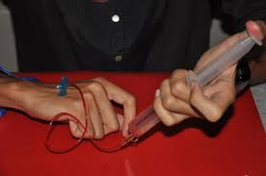
PROMOTE HEALING
Continue factor infusions as recommended by your hematologist
Maintains clot as you become more active
Prevents re-bleeding
Allow tissues to heal
Reduces risk of complications
# of infusions needed:
The type and severity of your bleeding disorder
The type and severity of your bleed
The amount of time between the bleed and your first infusion
https://discover.hubpages.com/health/Differences-between-Hemophilia-and-Thalassemia

Slide 33
PROMOTE HEALING - 1st 48-72 hours
P
Protect the joint/muscle from further damage and bleeding
Immobilize with a splint or brace
R
Rest (don’t use) the joint/muscle for 48-72 hours to prevent re-bleeding
If in a leg, keep weight off it (use crutches or walker)
I
Ice the area to reduce pain & swelling
Apply covered cold pack 10 min every 2 hrs while awake
If cold makes pain worse, stop using. Do not use heat
C
Compress the joint/muscle lightly with an elastic wrap to limit swelling
If pain worsens or numbness/ tingling develop, stop using
E
Elevate the joint/muscle to reduce swelling
Elevate above the heart if possible

Slide 34
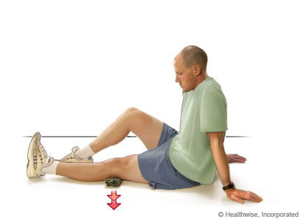
REGAIN STRENGTH & ROM
Start low, progress slow
Too much, too soon may cause re-bleed, delay recovery
Muscles take longer to heal than joints
Begin gentle exercise as inflammation decreases
Less swelling
No pain at rest
Start with gentle isometric strengthening exercise
Contract muscle without moving the joint
3-5 repetitions, 3-5 times/day
Gradually increase # repetitions/force
Myhealth.alberta.ca

Slide 35
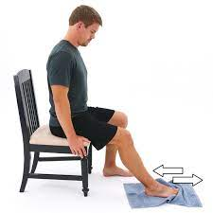
REGAIN STRENGTH & ROM
Add gentle ROM exercises within pain-free range
3-5 repetitions, 3-5 times/day, gradually increase reps
Do not force ROM
Gradually increase activity
Start with light activity
Avoid activities that cause pain
Gradually increase weight bearing
Contact HCWP Physical Therapist for recommendations, support!
https://www.hep2go.com/exercise_editor.php?exId=13125&userRef=0

Slide 36
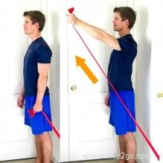
RETURN TO FULL RECOVERY
Light resistive exercise
Once full, pain-free ROM and no pain with light activity
Resistance bands and weight machines safer than free weights
Start low, progress slow
5 -10 reps once daily
Gradually increase # of repetitions
Then gradually increase amount of resistance
https://www.shoulder-pain-explained.com/shoulder-rehab-exercises.html

Slide 37
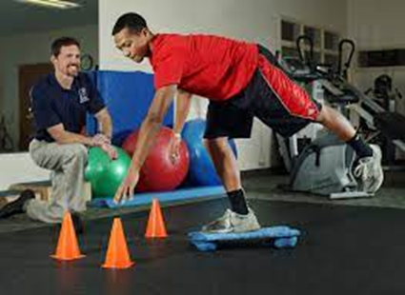
RETURN TO FULL RECOVERY
Outpatient Physical Therapy recommended for:
Recovery from large, repeated or complicated joint/muscle bleeds
Safe return to physically demanding activities/jobs or sport
Inform HTC PT
HTC PT will educate outpatient PT on bleeding disorder & rehab guidelines*
HTC PT provides support to PWBD & PT
Reduces risk of joint/muscle bleed during rehab process
Wosm.com

Slide 38
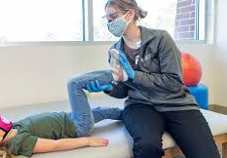
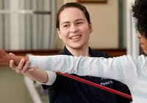
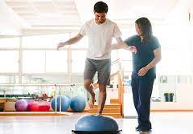
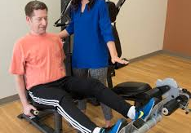
REHAB GUIDELINES FOR PWBD
If recommended by hematologist, prophy dose prior to PT
Start low, progress slow
Avoid:
passive ROM
heat modalities
deep massage
joint mobilizations > Grade 2
heavy resistance
aggressive electrical stimulation
If signs/symptoms of joint/muscle bleed, discontinue PT immediately
Resume PT when approved by hematologist
Contact HTC PT with any questions or concerns!
Lvhn.org
Adventisthealthcare.com
Healthydrivenchicago.com
Pt.wsutl.edu

Slide 39
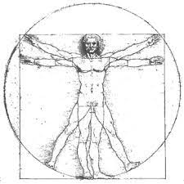
TAKE HOME MESSAGE
Prevent joint & muscle bleeds:
Partner with HCWP to set up prophy dosing that is right for you
Make healthy lifestyle choices
Be prepared:
Know signs & symptoms of joint/muscle bleeds
Have factor, supplies readily available
If joint/muscle bleed suspected:
Treat promptly (< 2 hours) including factor infusion and P.R.I.C.E.
Partner with HTC to treat bleed and regain strength & ROM
Return to activity gradually to avoid re-bleeding
Consider outpatient PT for complex bleeds and/or return to vigorous activity/sport

