Slide 1
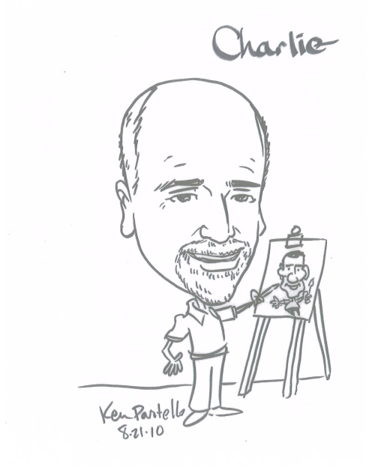
Psychosocial Aspects of Medical Trauma in the Bleeding Disorders Community
Charles P. Gilbert II, LCSW
Clinical Psychiatric Specialist
Hemophilia Treatment Center of Central Pennsylvania
Penn State Health
Hershey Medical Center, Hershey, PA
cgilbert@pennstatehealth.psu.edu

Slide 2
Objectives
Review medical trauma and stress experienced by PWH
Identify Family Responses
Identify Psychological Responses
Review Treatment Approaches

Slide 3
Trauma and Stressor-Related Disorders
Trauma and stressor-related disorders include disorders in which exposure to traumatic or stressful event is listed explicitly as a diagnostic criterion.
Reactive Attachment Disorder
Disinhibited Social Engagement Disorder
Posttraumatic Stress Disorder
Acute Stress Disorder
Adjustment Disorders
Other Specified Trauma- and Stressor-Related Disorder
DSM V, American Psychiatric Assn. 2013

Slide 4
Medical Trauma
Trauma Defined: Traumatic events are defined as those that involve a direct threat of death, severe bodily harm, or psychological injury that the person, at the time, finds intensely distressing.
Psychiatric manifestations related to trauma exposure include mood, anxiety, behavioral, identity, eating, and substance abuse disorders
Medical Trauma occurs in a medical care setting that is frightening, harmful, painful, isolating, and threatening, leading to significant emotional and psychological distress.

Slide 5
Risk Factors for Medical Traumatic Stress
Persons with a previous history of trauma
Children and adolescents
People with chronic illnesses
Individuals from marginalized communities

Slide 6
Symptoms of Traumatic Stress Disorder
Intrusive Re-Experiencing
Arousal, Hyper-Vigilance
Negative Mood
Avoidance
Dissociative/Cognitive Symptoms

Slide 7
PTSD & PTSS among PWH A & B
N = 178 PWH
57% (101) identified a hemophilia-related traumatic event
11.8% (21) met criteria for PTSD; 3X higher than Gen. Pop
Majority had not received a clinical diagnosis
Stahl, A., Barnett, K., Wilson, A., et al. PTSD and PTSS Symptoms Among Adults with Hemophilia A and B, 2023, Res Pract Thromb Haemost, 7.

Slide 8
Effects of Medical Trauma
Disrupted/Insecure Attachment
Avoidance of Healthcare Settings
Denial of Need for Care
Anxiety/Stress around medical decision-making
Distrust of Medical Staff
Family Conflict/Emotional Dysregulation
Self-Concept of Powerlessness

Slide 9
Treatment Approaches for Medical Trauma
Don’t Re-traumatize the Patient!
Educate
Understand the meaning
Cognitive Therapy
Psychodynamic Therapy

Slide 10
Hardiness Key Traits
Sense of control
Challenge orientation
Commitment to life roles

Slide 11
Resilience Key Traits
Ability to trust and form relationships
Sense of independence
Good problem-solving skills
Perseverance
Belief that lives have meaning and purpose

